Slide 1
Using Evaluation to Surpass the LIMITs of Agentic AI for Science
Contributions from: Robert Underwood, Franck Cappello, BPSW Team
Robert Underwood
Assistant Computer Scientist
Argonne National Laboratory
Extended Leadership Team
Best Practices for Scientific Workflows (BPSW)

Slide 2
What does it mean for an agentic system to be impactful?
Notes:
In scientific use cases, the impact of an agentic system for a use case is driven by the importance of its outcomes and by how broadly, correctly, robustly, efficiently, and quickly those outcomes are achieved

Slide 3
What does it mean for an agentic system to be impactful?
In scientific use cases, the impact of an agentic system for a use case is driven by the importance of its outcomes and by how broadly, correctly, robustly, efficiently, and quickly those outcomes are achieved

Slide 4
What does it mean for an agentic system to be impactful?
In scientific use cases, the impact of an agentic system for a use case is driven by the importance of its outcomes and by how broadly, correctly, robustly, efficiently, and quickly those outcomes are achieved
Motivation

Slide 5
What does it mean for an agentic system to be impactful?
In scientific use cases, the impact of an agentic system for a use case is driven by the importance of its outcomes and by how broadly, correctly, robustly, efficiently, and quickly those outcomes are achieved
Performance

Slide 6
What does it mean for an agentic system to be impactful?
In scientific use cases, the impact of an agentic system for a use case is driven by the importance of its outcomes and by how broadly, correctly, robustly, efficiently, and quickly those outcomes are achieved
Today’s Focus
Performance

Slide 7

My Perspective
Assistant Computer Scientist at ANL
  Lossy Data Compression (ECP, FZ, ZF, …)
  Data Management for AI (DataStates)
  AI for Science (AuroraGPT, Scout-CM)
  Light Sources (ECP, FZ, Illumine)
Modcon Best Practices for Scientific Workflows (BPSW)
    Extended Leadership Team
    Ambassador to SYNAPSE-I and MOAT

Slide 8

What’s a Best Practice?
Best Practices are “Patterns”
“... describes a problem which occurs over and over again in our environment, and the describes the core of the solution to that problem, in such a way that you can use the solution a million times over, without ever using it the same way twice”
Emphasis Added, Christopher Alexander as quoted in “Design Patterns: Elements of Reusable Object Oriented Software”

Slide 9
What’s a Best Practice?
“Patterns” have four elements:
Name of the pattern
Problem where is it useful
Techniques how to solve the problem
Consequences of using the pattern
However, names are hard‡, so today we’ll talk about problems, techniques, and consequences
‡ “There are only two hard things in Computer Science: cache invalidation and naming things.” – Phil Karlton

Slide 10
Goal of this Presentation
Illustrate best practices for five key LIMITs to evaluating Agentic AI
  Identify problems and their causes
  Provide Examples to illustrate the principle from my experience
  Techniques from the literature and their trade-offs
Encourage more robust thinking about evaluation

Slide 11
What LIMITs need surpassing for Agentic AI in Science?
Argument: Agents use cases especially face these challenges:
Limited Coverage: How do we know it is robust?
Inaccurate Criteria: What criteria should we use?
Multiple objectives: How do we align multiple good objectives?
Implementation Costs: Should we implement or evaluate?
Time-Delayed Rewards: Hard to determine outcomes without final results

Slide 12
Limited Coverage

Slide 13
Limited Coverage
You have an AI model for a system, you’ve tested it on some test data, but now it's time to transition to production
It fails, or you (or your colleagues) aren’t confident it will succeed
Often this is because of limited coverage of realistic data
When designing evaluations we need to ensure proper coverage

Slide 14
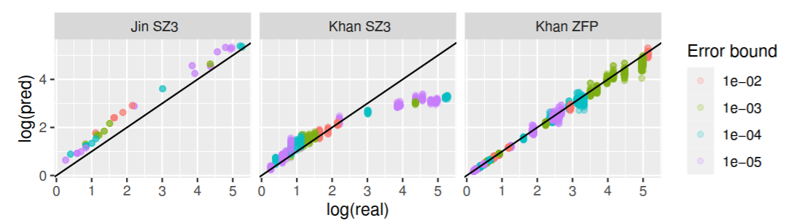
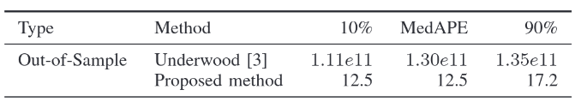
Example: Lossy Compressor Surrogate Evaluation
Poor performance for large values
How to identify coverage gaps in predictions?
Context
Dots represents predicted vs actual performance on tasks averserially chosen
Each figure represents different methods for the same task
Table shows numerical summaries of two generations of approaches by our team
Observations
Residual Plots p90/p99 🠖 identify gaps obscured by averages
Adversarial testing is critical to identify gaps, which then need to be categorized for next steps
Sometimes inaccurate estimation is desired
Systematic Overestimation at all values
Model wasn’t complex enough
A. Poulos, R. Underwood, J. C. Calhoun, S. Di, and F. Cappello, “Sensitivity and Impacts on Parallel Compression of Prediction of Lossy Compression Ratios for Scientific Data,” in 2025 IEEE International Parallel and Distributed Processing Symposium (IPDPS), Jun. 2025, pp. 1117–1128. doi: 10.1109/IPDPS64566.2025.00102.

Slide 15
Techniques for Identifying Limited Coverage
State Machine Methods: identify node, edge, or path coverage gaps using a simplified state machine
Entropy Methods: KL Divergence measures difference in distributions
Extrapolation Distance: measure the distance from the most similar sample (most useful for fixed state size)
Bayesian Epistemic Uncertainty: train the model on k subsets of data, and take the variance of the model predictions
Adversarial Methods: use optimization or search methods to find areas of poor model performance, and collect additional data there
Resource: Kochenderfer et al. “Algorithms for Validation” 2025

Slide 16
Inaccurate Criteria

Slide 17
Inaccurate Criteria
How do you decide how good is good enough?
There is often a trade-off between notions of quality and speed
Fast solutions are often of lower quality
High quality solutions are often slow
There may also be trade-offs between different kinds of quality
Being too strict/relaxed on what is acceptable often hinders other goals
When designing evaluations, we not set overly strict criteria

Slide 18
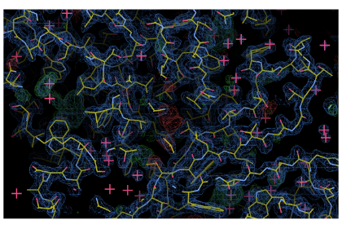
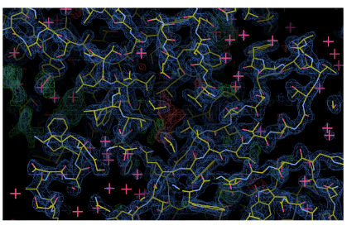
Inaccurate Criteria
What quality is good enough?
Context
SFX Beamline data for SLAC’s LCLS-II-HE
Goal: Reduce data volumes
Quality: Reconstruction of electron density
Lossless methods: only reduce by < 2x
About to show version with raw data image has been “2x2 binned” and and rounded to nearest 90ADU applied after preserving full fidelity on <1% of the data
Original
Expectations?
Observations
Diagnostically lossless data can be quite lossy
The lossy compressed version is 196.5x smaller
Allowing loss is important because AI introduces it
After Lossy Compression
R. Underwood, C. Yoon, A. Gok, S. Di, and F. Cappello, “ROIBIN-SZ: Fast and Science-Preserving Compression for Serial Crystallography,” Synchrotron Radiation News, pp. 1–6, Sep. 2023, doi: 10.1080/08940886.2023.2245722.

Slide 19
Techniques for Revealing Inaccurate Criteria
Work backwards from stated requirements
  How do downstream codes consume the data? E.g. maxima, spectra, etc…
  How do distributional assumptions match data? E.g. Gaussian vs Student’s T
  How does sampling affect the results? E.g. adversarial sampling vs random
Work backwards from architecture
  What happens if we remove aspects of the code/model? E.g. ablation studies

Slide 20
Multiple Objectives

Slide 21
Multiple Objectives
AI maximizes what we ask it for, sometimes we need to ask for multiple things
However, this presents some challenges
How should we measure the things we care about?
How should we determine what to choose when there are tradeoffs?
When designing evaluations, we need validate alignment of criteria

Slide 22
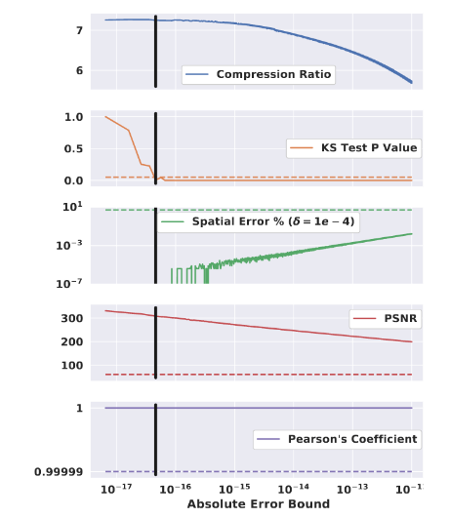
Examples of Multiple Objectives
Objective
Can we identify what objectives to use?
Context
Five measures of quality as a function
Real Goal: Maximize the top function such scientists can’t tell the difference in quality
Suggested Goal: Maximize the top function subject to the requirements (dashed lines) on the other 4
Observations
Sometimes criteria are not useful because they are never binding
We sometimes need to revisit this as we learn more information
Selected Configuration
*Binding
Criteria
Never Binding
R. Underwood, J. C. Calhoun, S. Di, A. Apon, and F. Cappello, “OptZConfig: Efficient Parallel Optimization of Lossy Compression Configuration,” IEEE Transactions on Parallel and Distributed Systems, vol. 33, no. 12, pp. 3505–3519, Dec. 2022, doi: 10.1109/TPDS.2022.3154096.

Slide 23
Techniques for Multiple Objectives
Weighting scalarize multiple objectives into a single objective that can be more easily optimized
Thresholding apply thresholds to all criterion but one, and then solve for the remaining criterion. Apply a penalty term proportional to the distance from the nearest valid configuration
Pareto Fronts highlight examples or configurations at the performance frontier
Instruments sometimes multiple inputs are correlated and can cause model collapse or singularity. Replacing them with a proxy can help

Slide 24
Implementation Costs

Slide 25
Implementation Costs
Curating high quality evaluation is time intensive
Humans are frequently the bottleneck in developing evaluations not computational time.
When designing evaluations we need to plan for scaling efforts

Slide 26

Evaluations for AuroraGPT
How can we evaluate models for customized for science?
Context
3 Year LDRD funded AI development effort at Argonne focused on improving AI for Science
Limited funds for the project
Frequently relied on volunteers to scale effort
Observations
Most experts have very narrow fields of expertise and are not interchangeable
You need to be very efficient with the expertise you can get
F. Cappello et al., “EAIRA: Establishing a Methodology for Evaluating AI Models as Scientific Research Assistants,” Feb. 27, 2025, arXiv: arXiv:2502.20309. doi: 10.48550/arXiv.2502.20309.

Slide 27
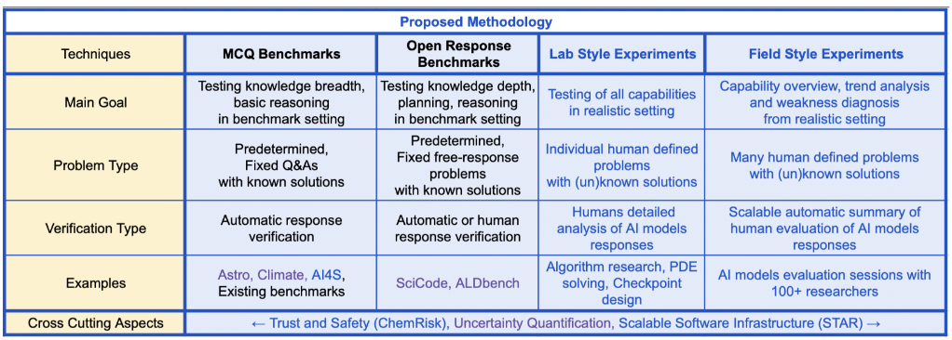
The EAIRA Methodology for Scaling Evaluation
F. Cappello et al., “EAIRA: Establishing a Methodology for Evaluating AI Models as Scientific Research Assistants,” Feb. 27, 2025, arXiv: arXiv:2502.20309. doi: 10.48550/arXiv.2502.20309.

Slide 28
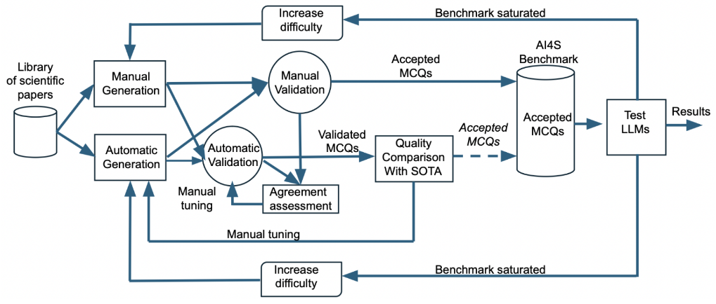
The EAIRA Methodology for Scaling Evaluation
The EAIRA paper describes a method to scale evaluations with automatic generation
Bootstrap with manual generation and validation
Train an automated generation approach
Train an automated validation approach
Validate the validation approach
Track saturation to trigger further refinement
F. Cappello et al., “EAIRA: Establishing a Methodology for Evaluating AI Models as Scientific Research Assistants,” Feb. 27, 2025, arXiv: arXiv:2502.20309. doi: 10.48550/arXiv.2502.20309.

Slide 29
Time Delayed Rewards

Slide 30
Time Delayed Rewards
Frequently, the value of a decision is not known until much later
It could be expensive to know
It could just be uncertain
AI systems struggle to improve with delayed rewards
We designing evaluations, we need find ways to refactor to immediate reward

Slide 31


Example: Red Light Green Light
How to Score Limb Movements?
Context
  Characters are agents in a physics sim
  Moving during a red light 🠖 failure
  Distance requires stopping ≥1 time
  Uses PPO: same algorithm as LLMs
Observations
  More complex 🠖 harder to train
  Sharp transitions 🠖 harder to train
  Agents like to take shortcuts

Slide 32
Techniques for Time Delayed Rewards
Prediction use an AI/statistical model to approximate future scores
Hierarchical break the problem into subproblems and score them
Bellman Equations backtrack scores of future states to current value
Branch and Bound penalize actions less fruitful than a proven cutoff
Monte Carlo Tree Search Like Methods
  select a promising state(s)
  expand it to successive states
  simulate its outcomes
  backpropagate promising directions

Slide 33
Conclusions

Slide 34
Conclusions
The LIMITs discussed
Limited Coverage
Inexact Criteria
Multiple objectives
Implementation Costs
Time-Delayed Rewards
Illustrate five key L.I.M.I.T.S. to evaluating Agentic AI
Identify problems and their causes
Provide Examples to illustrate the principle from my experience
Techniques from the literature and their trade-offs
I hope this has encouraged you to have more robust thinking about evaluation

Slide 35
Acknowledgements
(MODCON-BPSW) This work was produced at Argonne National Laboratory under Contract No. DE-AC02-06CH11357 with the U.S. Department of Energy.

