Slide 1
AI Powered Data Pipelines
Contributions from: Robert Underwood, Franck Cappello, BPSW Team
Robert Underwood
Assistant Computer Scientist
Argonne National Laboratory
Extended Leadership Team
Best Practices for Scientific Workflows (BPSW)

Slide 2



Goals of This Presentation
1
Understand the context of productivity in scientific workflows
2
Recognize that data is frequently a bottleneck in science
3
Survey the current boundaries of LLM capabilities with data
4
Provide practical advice on improving correctness for AI data pipelines
5
Explain the tradeoffs between frontier and open models
6
Provide a practical process for developing and scaling data pipelines

Slide 3

My Perspective
Assistant Computer Scientist at ANL
  Lossy Data Compression (ECP, FZ, ZF, …)
  Data Management for AI (DataStates)
  AI for Science (AuroraGPT Data coLead, Scout-CM)
  Light Sources (ECP, FZ, Illumine)
Modcon Best Practices for Scientific Workflows (BPSW)
    Extended Leadership Team
    Ambassador to SYNAPSE-I and MOAT

Slide 4
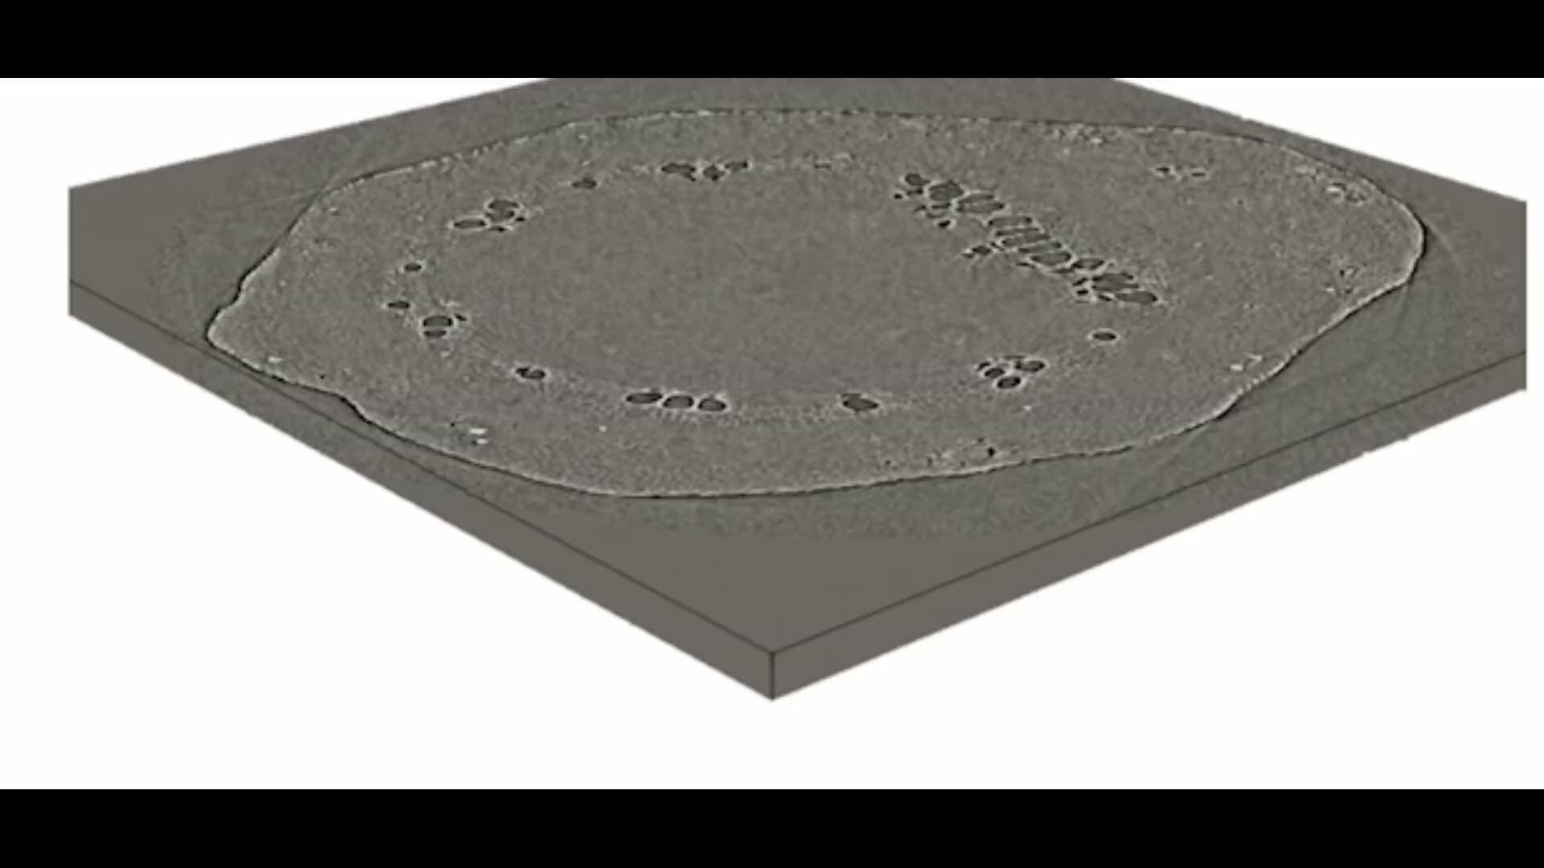
What Does AI Mean for Productivity in Science?
General very few large studies measuring “global” productivity
Initial results suggest modest but meaningful impacts for programming related tasks
  META [1] using IDE usage telemetry metrics found a 6-12% increase productivity improvement one year after AI rollout with greater effects for senior staff
  Google [2] found approximately 10% productivity improvement across the company
  Stanford [7] reports net gains of 15-20% including rework based on 100k devs
Context The Federal Reserve[5] reports an average 2.1% increase/year since 1950
Science The Genesis Mission BPSW team finds large “task-specific” advantage
SYNAPSE-I (beamlines) achieved 2976x speedup for reconstruction+segmentation
MOAT (accelerator) team measured >100x speedup for specific accelerator operations
Mitigating Concerns
“J-curve” delayed productivity improvements with AI [2] may explain some results [6]
Increased code “churn” with the use of AI [3]
AWS increased downtime, and implemented mandatory review of AI written code [4] to mitigate acquiessnce bias
3D Segmentation of Xylem transporting water through a plant stem in real-time
Credit: Genesis Mission Synapse-I
Notes:
Aside the goal of the Genesis Mission is to accelerate science by a factor of 2 over a ten year period
If we think of this as compounding interest
At 2.1% we get to a 23% improvement
At 6% we get to a 79% improvement
At 9% we get a 173% improvement
At 20% we a 519% improvement
We need to get a 7.2% improvement in productivity each year on average

Slide 5
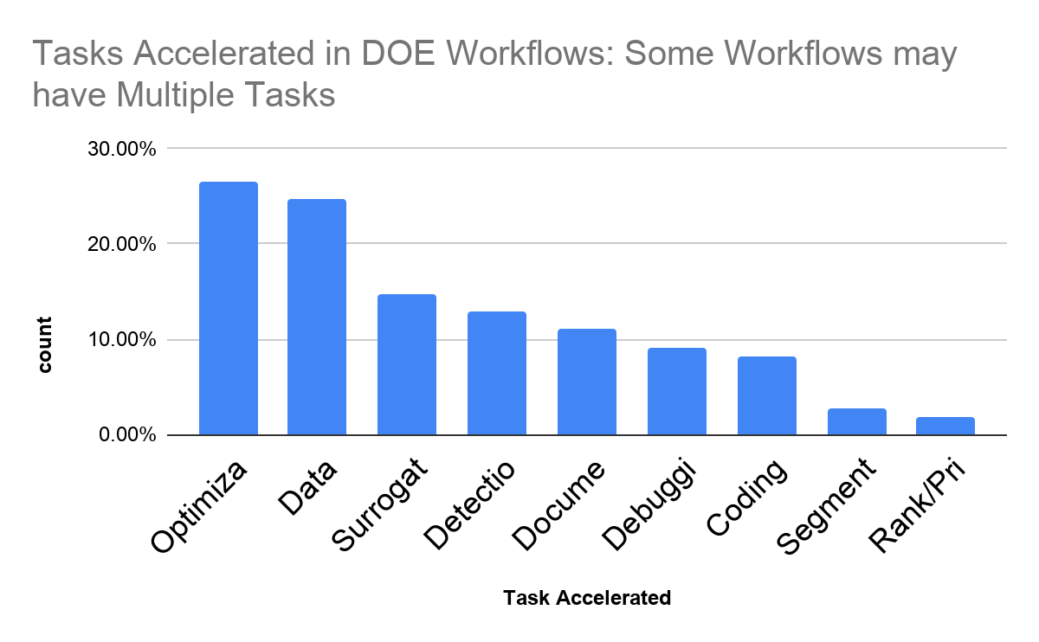
What are the tasks accelerated with AI?
In a BPSW survey of 154 Unclassified DOE scientific workflows, of the teams that provided information, the following tasks were accelerated with AI:
25% optimize/control some process
24% clean/preprocess data
12% identify/detect features
Other data tasks: detection, segmentation, …
Overall ~34% of accelerated tasks involve data
We expect that over the Genesis Mission more kinds of tasks will be attempted and accelerated with AI
Notes:
Over all tasks related to data, it is about 34% the data processing was a time consuming task accelerated with AI.

Slide 6
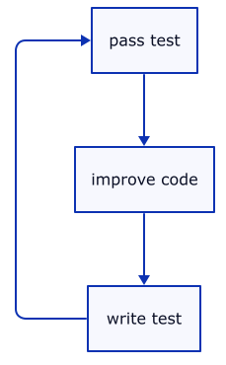



Is AI Good at Data Cleaning Tasks?
General-Purpose Data Analysis Tasks
Frontier models succeed at python data analysis tasks ~70% of the time when given acces to tools within 20-30 turns [8]
Turns can be “automated” using agentic harnesses (e.g. claude-code, cursor)
“Ralf” Loops (A form of “test driven developement” for LLMs) can automate this
High Performance Data Analysis for Large (e.g. TB+) Datasets
Processing all of HACC’s Last Frontier simulation on all Polaris even with tiny models would take months using AI without using “tools” -> use selectively
Parallel [12] or distributed computing [11,12] tend to be harder (~42-60% correct) and upto 70% slower than hand tuned codes on realistic tasks.
Some frameworks (e.g. MPI) are much more resistant to AI implementation [11]
Domain Specific Analysis Tasks (e.g. Biology)
Tasks requiring domain expertise (e.g. specialzed terms), drops to ~60%[9]
This result is independent of increased difficulties of HPC
When provided domain specific tools and docs this can go upto ~90% [10]
Test Driven Development
Common AI Harnesses
Notes:
Think back to the vibe-coding lecture from last time.

Slide 7
Best Practices for Optimizing AI for Data Tasks
1. Translate to easier tasks
Code Translation > New Dev
Python > C++
Standard > Bespoke Formats
Specific > Ambiguous Tasks
2. Explicit Context
Provide Correct/Incorrect Examples
State Implied Knowledge Explicitly
Clear (Automated) Acceptance Criteria
3. Advanced Refinement
Scale inference correctness using advanced techniques like majority voting or leveraging an LLM as a judge to validate and improve results.
Notes:
You can think back to the RECIPE framework Role, Expectation, Context, Input, Parameters Examples covered in the prompt engineering lecture

Slide 8
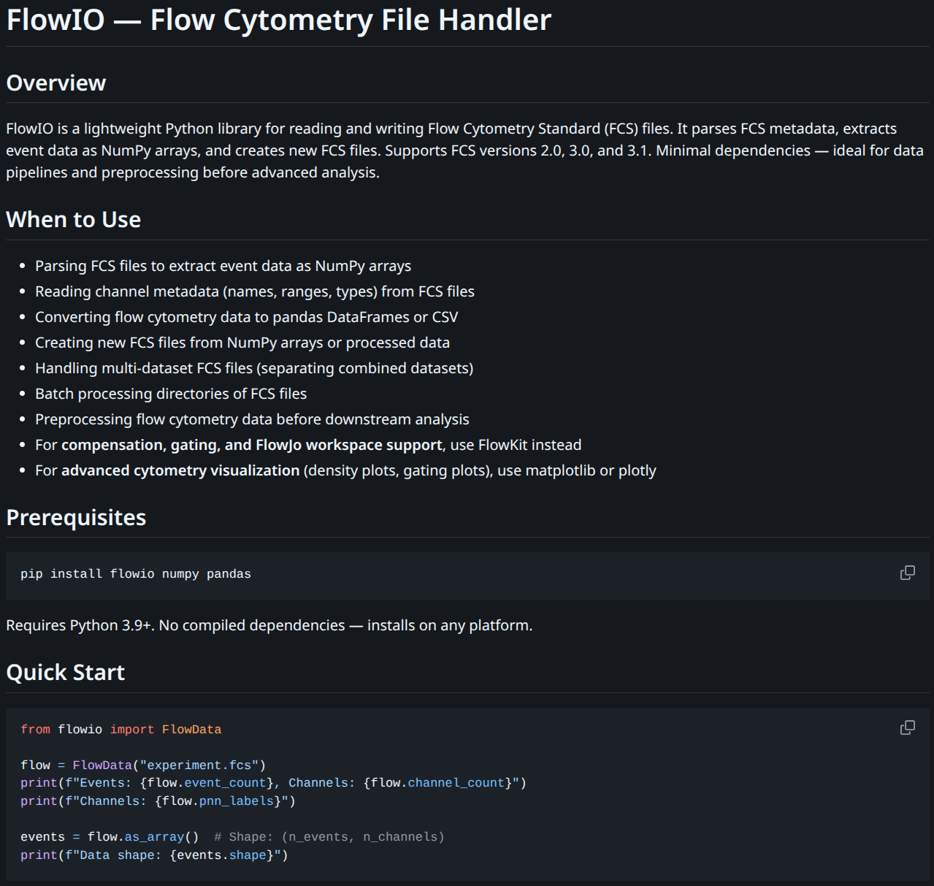
Practice: How Do We Provide Domain Skills to Models?
Skills are “markdown” files with key sections
Overview of the skill
List of uses for the skill
Installation Instructions (via a binary package)
Commented quick-start example codes
Reference links to up-to-date documentation
Model Context Protocol (MCP)
A simplified version of FastAPI
Example Skill File [10]

Slide 9

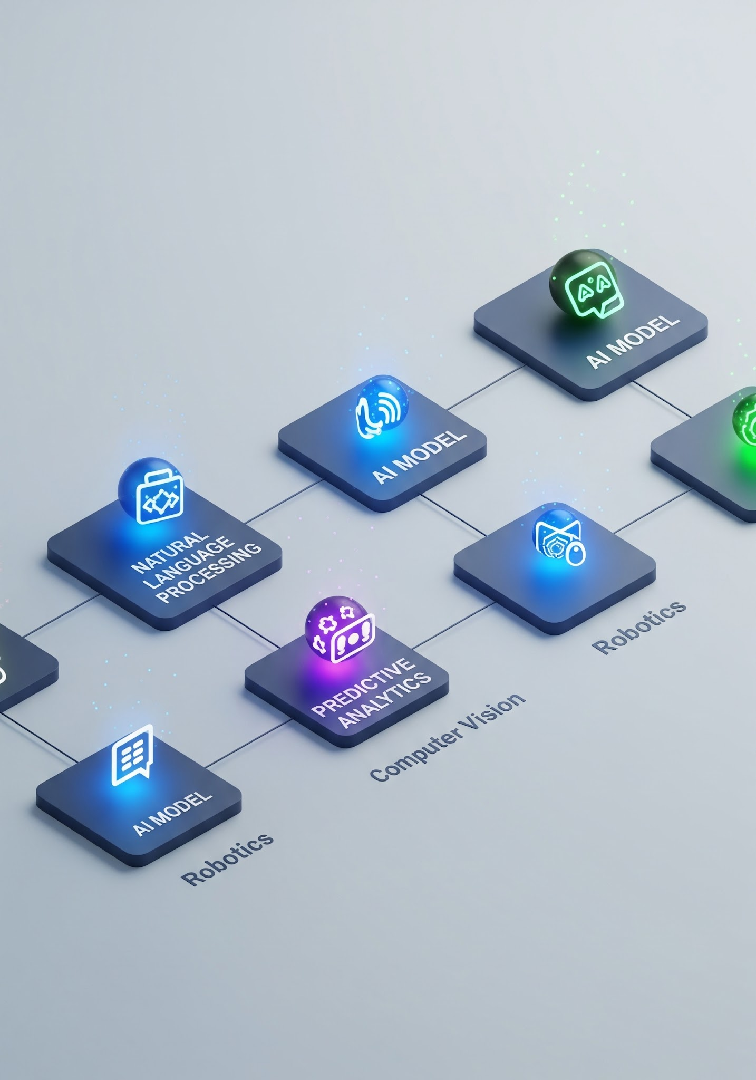
Practice: What Models Should I Use?
Not all models are equally good at all tasks
Sometimes LLMs are good enough
Highly specialized multi-modal tasks often benefit from domain-specific models
E.g. OlmoOCR/DeepseekOCR for PDF parsing, SAM3 for segmentation
Sometimes a model is great, but too expensive
  Fixes: Distillation, Adaptive Algorithms
Almost Always Use a Harness
This mitigates gaps in the ability of the model to “natively” understand data
Ultimately you need to benchmark what model+harness works best

Slide 10
Practice: What Models should I use? Frontier Models
Often most capable therefore probably a reasonable default.
Where are things currently? (changes every ~2-3 months)
Google Gemini -> tends to lead multi-modal analysis, often lowest costs
OpenAI -> tends to lead long run reasoning with strong text and code models
Anthopic Claude -> tends to lead tool (agentic) use, often highest costs
How to use? Vendors hosts versions of frontier models certified for CUI or Classified data.
Personal Reccomendation:
Use a Institution provided endpoint + harness + recent models from ChatGPT or Gemini
Write code and test in a vendor agnostic way where possible

Slide 11
Practice: What Models should I use? Open Models
Advantages
Can be “fine-tuned” for a specific use case (not for faint of heart) with modest improvements for in benchmarks at the same number of parameters.
Can be scale on ALCF for very large runs (Aegis) where needed
Simpler security and approvals model; nothing leaves your institution.
Weakness: often behind frontier models -> longer development cycles
Personal Recommendation
Gemini 4 31B(better) / 26-A4B(faster) and GPT-OSS 120B for general use
  Check Artificial Analysis/Hugging Face/Genesis Leaderboard for Current State of Art
Consider specialized models: coding, specific domains (e.g. bio), embedding (Qwen3-Embedding), segmentation (e.g. SAM3), etc… where appropriate
  Speed vs Cost, Quality on the task, etc…
Use institution provided models for interactive or Aegis for large batch jobs on HPC

Slide 12
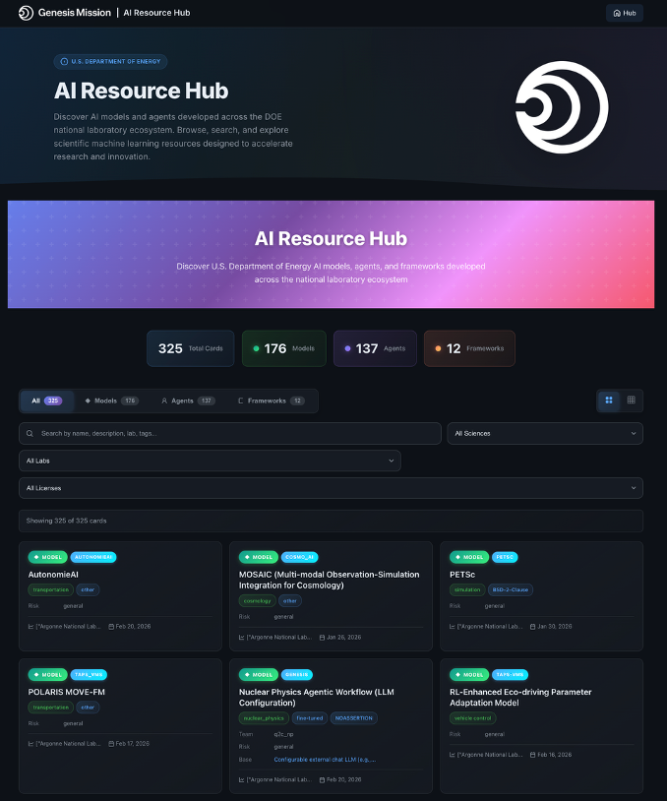
A Development Process for Data Pipelines
Plan
Source
Pilot
Evaluate
Scale
Has someone else done this better?
What do I hope to accomplish with this pipeline?
What are possible approaches?
What are my Ethical and Legal Responsibilies?
Where and can I find source data?
Do I need to collect, simulate, extract?
Avoid costs of iterating at scale, by testing key components manually on a few examples.
How much will it cost?
Did the pilot produce what you hoped for?
How do you know?
How can I detect if something goes wrong as I scale?
Improve the bandwidth
Improve the quality
Improve the scope
Increase the data size
Archive the data according to FAIR[13] for others to use

Slide 13
Example from Scout-CM: Building Linear Process Maps
Plan
Source
Pilot
Evaluate
Scale
Pre-existing: Not in AI-ready machine readable format
Goal: Understand flow of critical minerals in the economy
S&T Risk Matrix concerns for outputs of analysis
Sources:
Scientific Papers
Gov’t Databases
Standards (HS-6)
Economic Data
Wide ranges of formats
Target: Graph
Produce a linear process map for Aluminium
First prototype would have taken over 4.9 days to run
Considering:
HS-6 matches correct?
Flow matches correct?
Is it scaleable?
We found:
In some cases existing flow matches are always incorrect
Some things we did:
Split AI vs non-AI work, saving AI for hard cases
Model choice optimized
Checkpointing
Now at ~30 min/run
Many more things to scale and improve

Slide 14
Example from AuroraGPT: Curating 10TB+ of Science Text
Plan
Source
Pilot
Evaluate
Scale
Pre-existing: At the time, no. Prior work focused on web
Goal: Is AI better with more science?
Copyright and Licensing are major concerns
Sources:
Preprint Servers
DOE OSTI/Panda
Publishers
Connections of senior lab staff
Scraping*
Other
Most but not all in PDF format. Important Metadata in other formats
This is extremely costly to do correctly: 10k+ GPU node hours for some datasets
Start from smallest to largest as we optimize
We conducted a study of user parser preference and runtime/scaling
We found
Fast parsers work frequently
Slower but high quality ones are essential
Some things we did:
Port to Aurora
Checkpointing
Memory usage
I/O to read files
We share the data on request internally subject to legal agreements
* Requires specific approval from ANL Librarian!!

Slide 15
Acknowledgments
Modcon: This work was produced at Argonne National Laboratory under Contract No. DE-AC02-06CH11357 with the U.S. Department of Energy.
AuroraGPT, Scout-CM: This material is based upon work supported by Laboratory Directed Research and Development (LDRD) funding from Argonne National Laboratory, provided by the Director, Office of Science, of the U.S. Department of Energy under Contract No. DE-AC02-06CH11357.
AuroraGPT-INCITE: An award of computer time was provided by the U.S. Department of Energy’s (DOE) Innovative and Novel Computational Impact on Theory and Experiment (INCITE) Program. This research used resources from the Argonne Leadership Computing Facility, a U.S. DOE Office of Science user facility at Argonne National Laboratory, which is supported by the Office of Science of the U.S. DOE under Contract No. DE-AC02-06CH11357.

Slide 16
Bibliography
[1] Gradle Technologies, Measuring the Impact of AI on Developer Productivity at Meta, (Oct. 10, 2025). Accessed: Apr. 23, 2026. [Online Video]. Available: https://www.youtube.com/watch?v=1OzxYK2-qsI
[2] Lex Fridman, Sundar Pichai: CEO of Google and Alphabet | Lex Fridman Podcast #471, (Jun. 05, 2025). Accessed: Apr. 23, 2026. [Online Video]. Available: https://www.youtube.com/watch?v=9V6tWC4CdFQ
[3] W. Harding and M. Kloster, “Coding on Copilot: 2023 Data Shows Downward Pressure on Code Quality 150m lines of analyzed code + projections for 2024.” GitClear, Jan. 16, 2024. Accessed: May 27, 2025. [Online]. Available: https://gwern.net/doc/ai/nn/transformer/gpt/codex/2024-harding.pdf#page=15.07
[4] The Financial Times, “After outages, Amazon to make senior engineers sign off on AI-assisted changes,” Ars Technica. Accessed: Apr. 23, 2026. [Online]. Available: https://www.ft.com/content/7cab4ec7-4712-4137-b602-119a44f771de
[5] Federal Reserve Bank of St. Louis, “Nonfarm Business Sector: Labor Productivity (Output per Hour) for All Workers.” Accessed: Apr. 23, 2026. [Online]. Available: https://fred.stlouisfed.org/series/PRS85006091
[6] J. Becker, N. Rush, E. Barnes, and D. Rein, “Measuring the Impact of Early-2025 AI on Experienced Open-Source Developer Productivity,” Jul. 25, 2025, arXiv: arXiv:2507.09089. doi: 10.48550/arXiv.2507.09089.

Slide 17
Bibliography
[7] Yegor Denisov-Blanch, Does AI Actually Boost Developer Productivity? (100k Devs Study) - Yegor Denisov-Blanch, Stanford, (Jul. 23, 2025). Accessed: Apr. 23, 2026. [Online Video]. Available: https://www.youtube.com/watch?v=tbDDYKRFjhk
[8] R. Ma et al., “Can AI Agents Answer Your Data Questions? A Benchmark for Data Agents,” Mar. 21, 2026, arXiv: arXiv:2603.20576. doi: 10.48550/arXiv.2603.20576.
[9] L. Mitchener et al., “BixBench: a Comprehensive Benchmark for LLM-based Agents in Computational Biology,” Mar. 08, 2025, arXiv: arXiv:2503.00096. doi: 10.48550/arXiv.2503.00096.
[10] jaechang-hits, jaechang-hits/SciAgent-Skills. (Apr. 25, 2026). Python. Accessed: Apr. 25, 2026. [Online]. Available: https://github.com/jaechang-hits/SciAgent-Skills
[11] D. Nichols, J. H. Davis, Z. Xie, A. Rajaram, and A. Bhatele, “Can Large Language Models Write Parallel Code?,” in Proceedings of the 33rd International Symposium on High-Performance Parallel and Distributed Computing, in HPDC ’24. New York, NY, USA: Association for Computing Machinery, Aug. 2024, pp. 281–294. doi: 10.1145/3625549.3658689.
[12] J. Zhu et al., “CUDABench: Benchmarking LLMs for Text-to-CUDA Generation,” Feb. 13, 2026, arXiv: arXiv:2603.02236. doi: 10.48550/arXiv.2603.02236.

Slide 18
Bibliography
[13] M. D. Wilkinson et al., “The FAIR Guiding Principles for scientific data management and stewardship,” Sci Data, vol. 3, no. 1, p. 160018, Mar. 2016, doi: 10.1038/sdata.2016.18.

